Slide 1
Minnesota River and Greater Blue Earth River Basin
Total Suspended Solids TMDL Study
Katrina Kessler, P.E. | Assistant Commissioner, MPCA
August 20, 2019

Slide 2
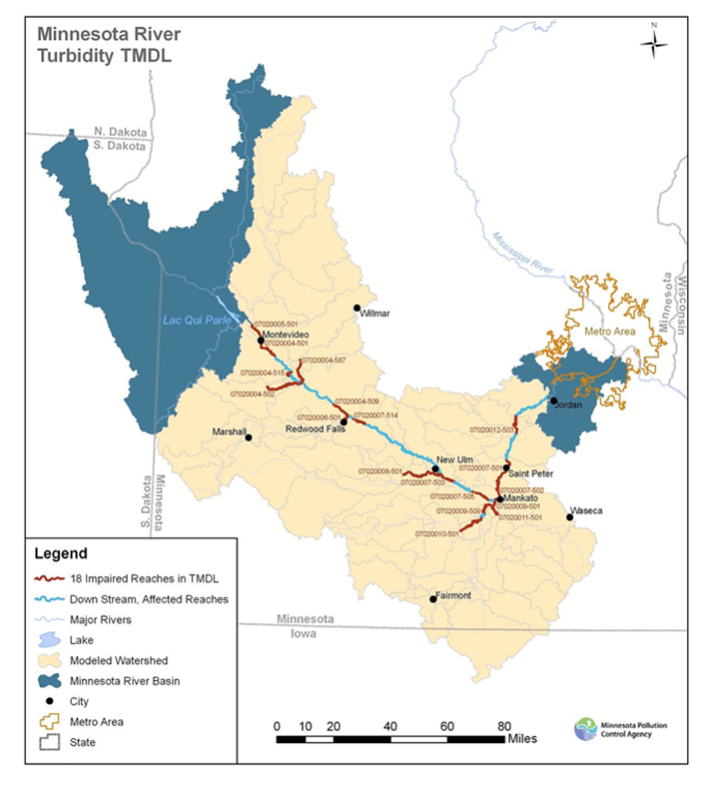
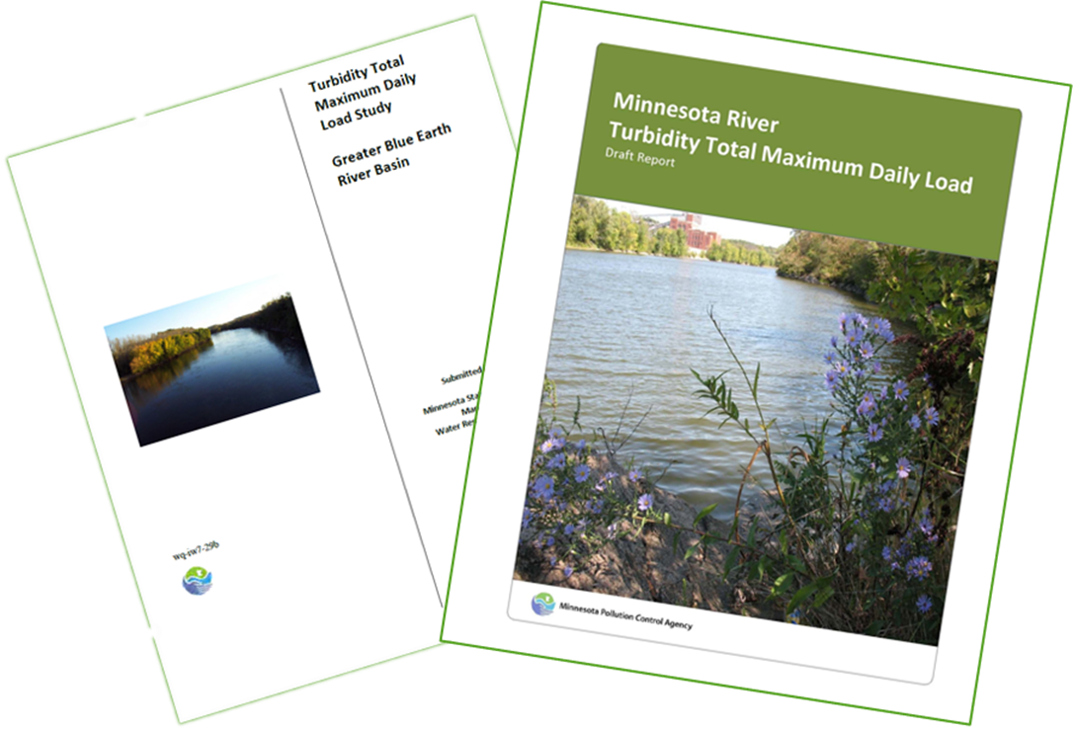
Brief history of turbidity TMDLs
Minnesota Turbidity River: 18 main stem and sub watershed reaches
Greater Blue Earth River watershed:
39 reaches in Blue Earth, Le Sueur and Watonwan watersheds
Draft TMDLs developed and placed on public notice in 2012
Both TMDLs:
  Based on TSS surrogates for turbidity
  Extensive stakeholder processes
  Received contested case hearing requests based on natural background and MS4 concerns
Notes:
Draft TMDLs for the Minnesota River and the Greater Blue Earth Watersheds were developed and placed on public notice in 2012
*Two separate TMDLs were developed for the mainstem Minnesota River turbidity impairments and the Greater Blue Earth (Watonwan, Blue Earth, Le Sueur) turbidity impairments
*Where paired data existed we had a TSS translator
*Separate but parallel stakeholder processes
*Both reports were challenged with Contested Case Hearing Requests by Soy Bean Growers, Brown County Corn and Soybeans, Mankato, Marshall, MCSC, citizens

Slide 3
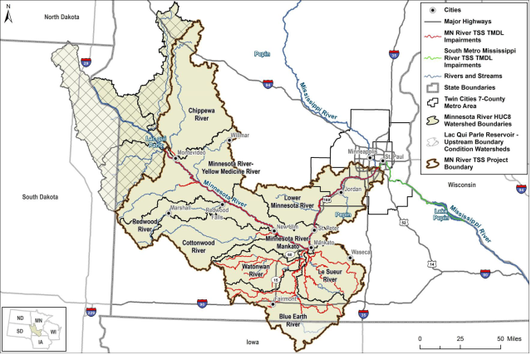
Brief history of turbidity TMDLs, continued
MPCA engaged in negotiation and response to TMDL challenges
2015: Turbidity standard replaced with total suspended solids (TSS) standard, 65 mg/L
2016: New basin model developed
  Mainstem reaches of the Minnesota River consolidated into fewer, longer reaches
  As a result, entire river below Lac qui Parle Dam now listed as impaired for TSS
Decided to withdraw both TMDLs, redevelop as one TMDL study
Notes:
*Long process ensued to develop Findings of Fact and to negotiate with challengers, from 2012 - 2015
*MPCA adopted TSS standard to replace turbidity standard in 2015. TSS measures a quantifiable load of solids in the water. This is much more in line with a total maximum daily load calculation than turbidity which measure how much light penetrates the water column. Even when we had a turbidity standard, we developed TMDLs using a surrogate TSS value. WQS for MN River is 65 mg/L for entire reach.
Made the allocations in the original TMDL outdated – needed recalculation.
*HSPF model of the MN River Basin updated and extended in 2016, included more data and longer period of time, better source assessment
*Multiple AUIDs of the mainstem consolidated into fewer, longer reaches. Impairments carried through to the new WIDs so entire river downstream of LqP dam is now listed as impaired for turbidity or TSS.
*Decided to withdraw both TMDLs, redevelop as one TMDL study: Letters sent to EPA, stakeholders and commenters

Slide 4
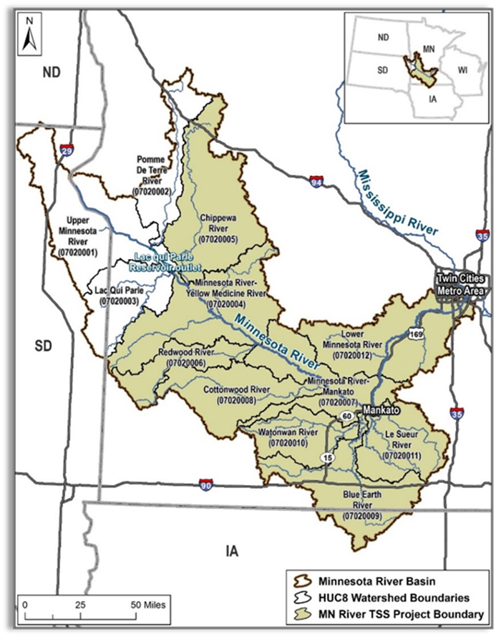
Total Suspended Solids TMDL study
2016: Tetra Tech contracted to draft new TMDL
Addresses 61 turbidity and TSS impairments
Consolidation of reaches along MN River main stem
HSPF model update
Allocation approach for MS4s
Analysis of conditions for high sediment loading
Reasonable assurance
Addresses many concerns raised during the original public notices
Overall, calls for apx. 50% reduction in sediment
Notes:
*12 Main stem and 49 tribs to get to 61
Draft TMDL addresses all TSS/turbidity impairments along MN River mainstem, impairments at the mouths of Chippewa, Yellow Medicine, Hawk Creek, Redwood, Cottonwood and most of the Greater Blue Earth sediment impairments. A handful have been added to the impaired waters list since the TMDL was drafted.
*All TMDLs developed based on standard of 65 mg/L. Original MN River TMDL had different targets in the basin based on different turbidity to TSS relationships.
*The basin HSPF model was updated in 2016. Developed at HUC-12 scale, extended through 2012, calibrated to new data.
*Allocations for MS4s based on same sediment export rate as used in South Metro Miss TMDL. Assumed SWPP compliance meets 65 mg/L. No reductions required of MS4s. No reductions required from WWTPs.
*Used HSPF model to look at 18 years of data seasonality (55% March – June), snow melt, less cover, high intense storms, informs when we need practices on the land and what type of practices are needed to mitigate
*Reasonable assurance section greatly expanded and consistent with Lake Pepin TMDL, refers to actual practices that are being implemented AWQC, WRAPS, 1W1P, Buffers, CWF $
Addressed MS4 concerns which were many of the concerns
*Each reach has a different reduction estimate, but overall we are calling for about a 50% reduction in sediment loads.

Slide 5
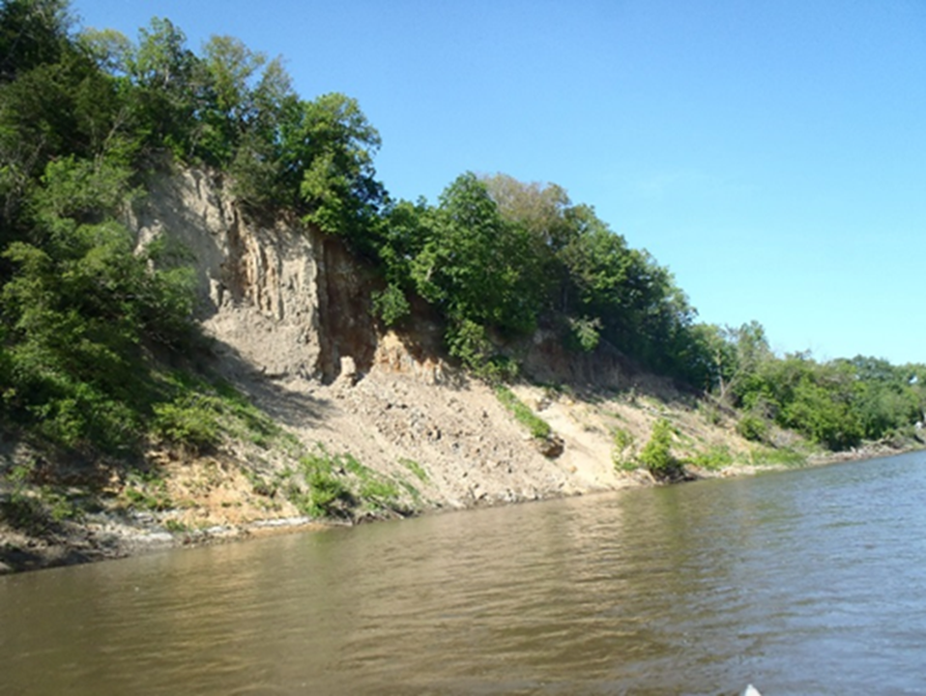
Total Suspended Solids TMDL study continued
June 2018: Pre-public notice
Met with Lower Minnesota Watershed District
Nov. – Dec. 2018: U.S. EPA preliminary review
Early 2019: Work through EPA comments
Consistent with downstream South Metro Mississippi TSS TMDL
Draft completed at same time as three other Minnesota River Basin WRAPS/TMDL
July 2019: Public notice period, extended to 60 days (July 11 – September 20, 2019)
Notes:
*All original stakeholders were notified of the pre-public notice. Draft TMDL was posted on website for 30 days. Contacted MN Corn Growers, MN Soybean Growers, MCEA, Stormwater Coalition, MAWRC and Lower MN Watershed District to arrange individual meetings. Only Lower MN WD chose to meet.
*EPA prelim review went through two rounds of comments. Process delayed because of federal govt shutdown. Biggest issue was ensuring MN River TMDL was consistent/didn’t violate allocations in downstream South Metro Miss TSS TMDL.
*Completion of draft MN River Greater Blue Earth TSS TMDL coincided with the completion of three MN River Basin HUC-8 WRAPS– Watonwan, Lower MN and MN River at Mankato. Decision was made to public notice all of them simultaneously for an extended period of time (60 days), proactive

Slide 6
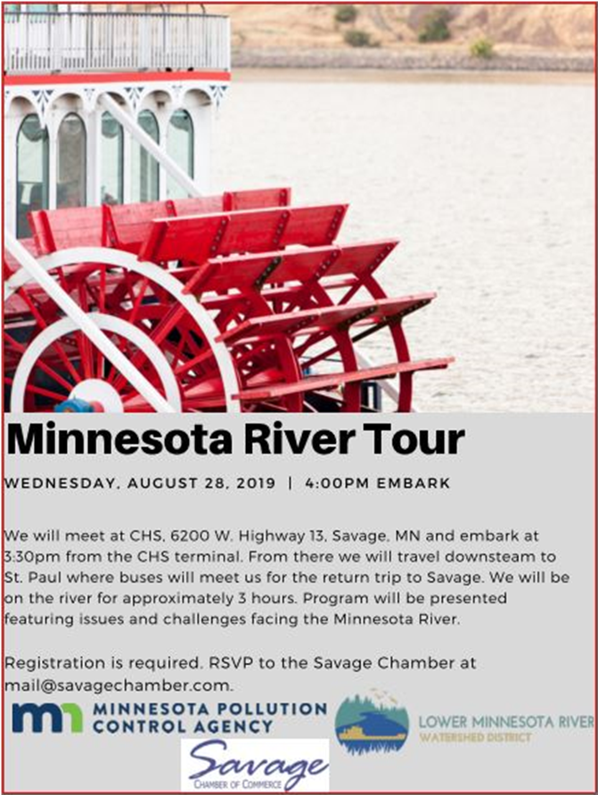
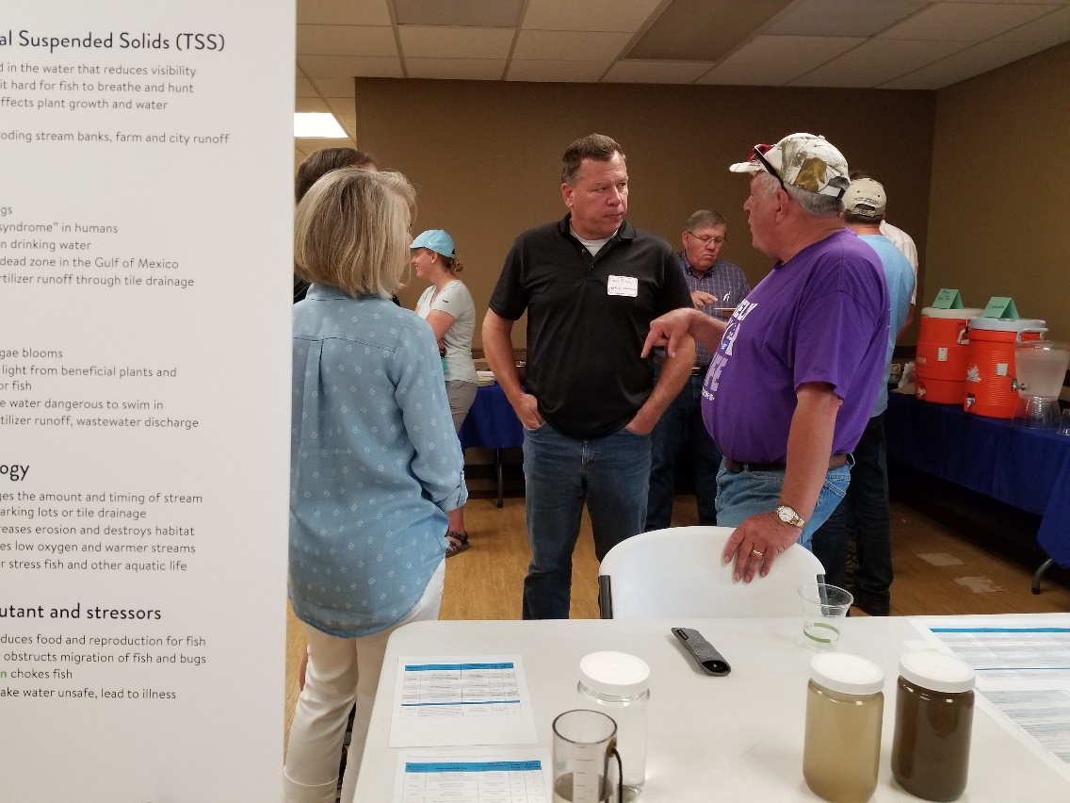
Stakeholder and outreach events
Open house in Mankato (July 31)
Estimated 80-100 people attended
Farm tour near New Prague (Aug. 28)
In coordination with MDA, Ag Water Quality Certification
Boat tour of Lower Minnesota River (Aug. 28)
In coordination with Lower Minnesota Watershed District and Savage Chamber of Commerce
Lake Pepin Legacy Alliance Open House (Aug. 29)
Notes:
*Open House held in Mankato. Two informal presentations were made and 6 stations were set up for people to visit and ask questions. Turnout was good with representation from legislators, individual farmers and farming organizations, tribal representation, county commissioners, county and SWCD staff, other state agencies, Lake Pepin Legacy Alliance and Freshwater Society.
*Showcase of Farm Best Management Practices and Ag Water Quality Certification presentation at Greg Entinger farm near New Prague.
*Boat tour of the Lower Minnesota River co-sponsored by Lower MN River Watershed District and the Savage Chamber of Commerce. Emphasis on the impacts of sediment deposition in the channel.
*Attendance and presentation at Lake Pepin Legacy Alliance open house – highlight the connections with TP and sediment reductions in the MN River

Slide 7
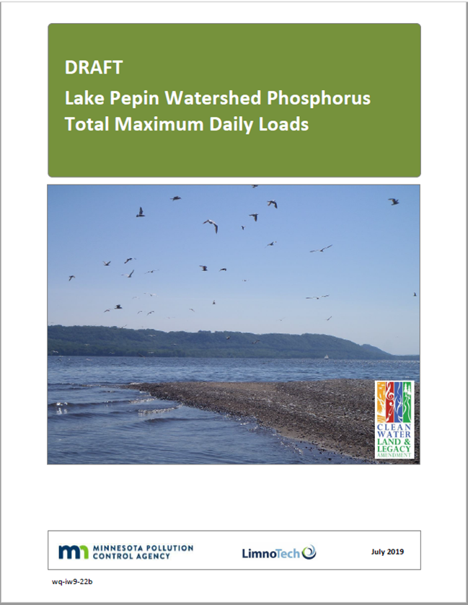
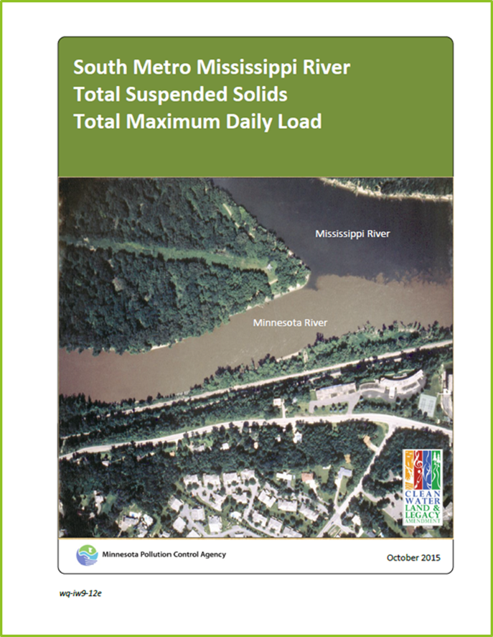
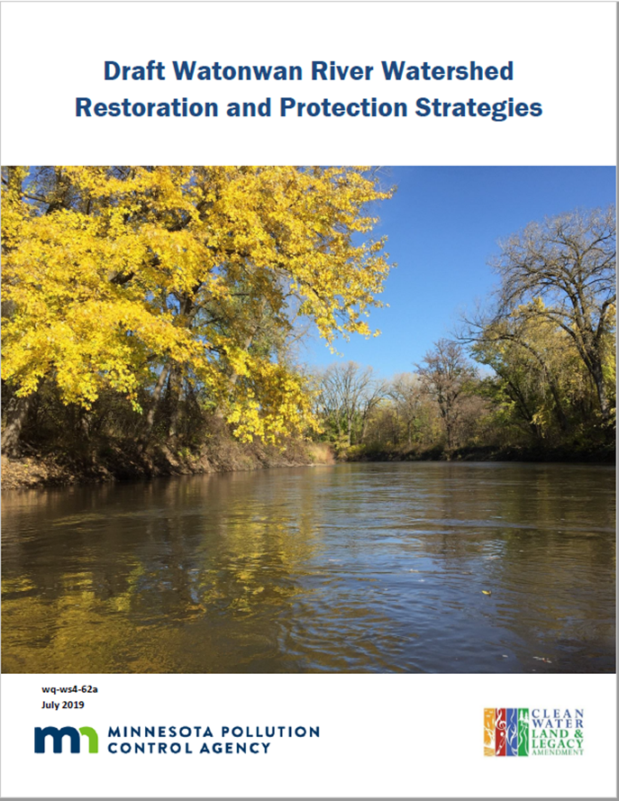
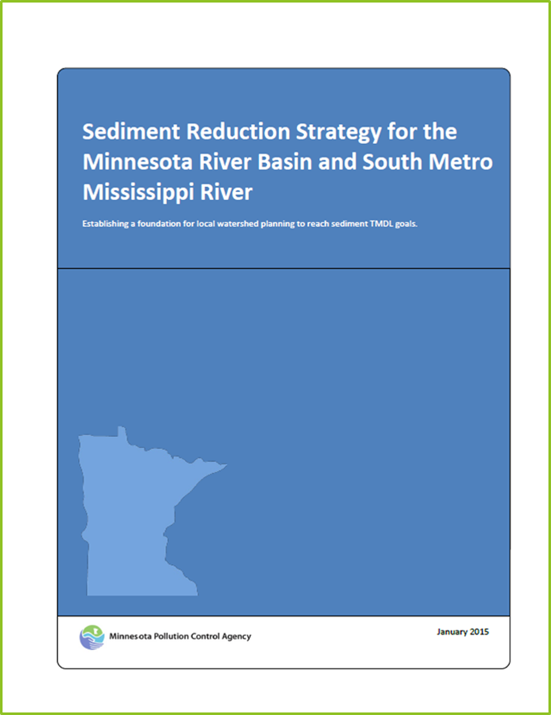
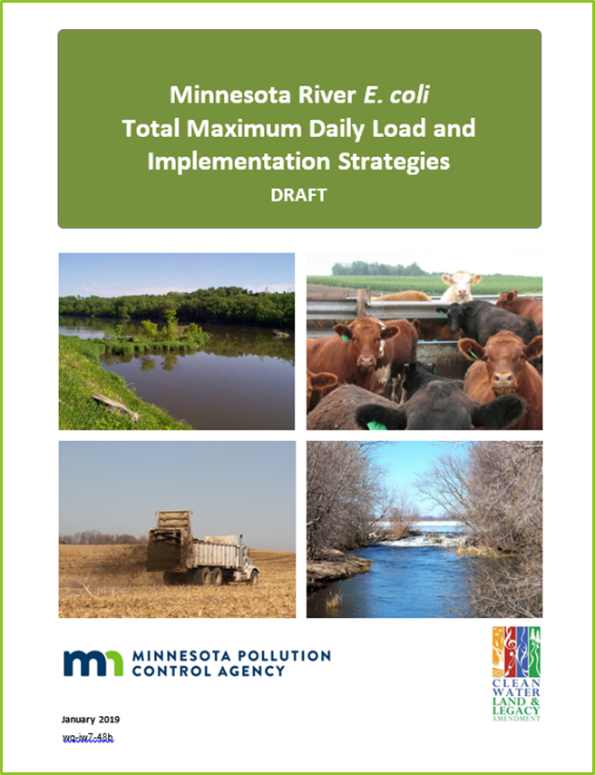
Connections to other projects
Watershed WRAPS, TMDLs and 1W1P
South Metro Mississippi TSS TMDL
Lake Pepin TMDL
Minnesota River Bacteria TMDL
Sediment Reduction Strategy
Notes:
*Draft MN River Greater Blue Earth TSS TMDL covers most of the MN River Basin, but implementation strategies and planning occurs at smaller watershed scale. Watershed WRAPS and TMDLs approved or on notice in seven of the twelve Minnesota River Basin major watersheds. Remaining five watershed WRAPS are in various stages of development. Three watersheds with approved or underway 1W1Ps.
*Draft TMDL is consistent with downstream South Metro Miss TSS TMDL, approved by EPA in 2016. Achieving MN River TSS TMDL will be critical to achieving South Metro TMDL.
*Because of phosphorus affinity to bind to soil, achieving the MN River TSS TMDL is critical to achieving phosphorus reductions in Lake Pepin. Also, for reducing filling (sedimentation) of Pepin.
*Lake Pepin TMDL is currently available during a pre-public notice review
*Conditions that deliver sediment are also associated with delivering bacteria. Bacteria TMDL approved spring 2019.
*Sediment Reduction Strategy from 2015 identified broad strategies to reduce sediment in Mn River and South Metro Miss.

Slide 8
Sediment Reduction Strategy
Knowledge gaps:
How much sediment can be reduced by reducing high river flows?
What are the most critical times for reducing sediment and flow?
How much flow can be reduced by water storage during critical times?
What individual BMPs and suites of BMPs can best achieve flow and sediment reductions?
Notes:
Purpose – developed to provide high level strategies required in the Miss Metro TSS TMDL and original turbidity TMDL.
*Gaps in knowledge identified – connecting practices on the land with quantified reduced flow and reduced TSS.
*Answers to these questions will determine if an update to the sediment strategy should be completed

Slide 9
Sediment Reduction Strategy continued
Critical condition analysis completed for high flows and sediment delivery
  Analysis incorporated into draft TMDL
BMP effectiveness modeled for three Minnesota River Basin watersheds
  Potential to expand modeling efforts to more watersheds in the basin
  Results inform overall strategy as well as watershed WRAPS
Notes:
*2018 project fill in knowledge gaps
Lit review
Peak TSS events
Quantify flow reduction and TSS relationships
Tile drainage storage
Effects of individual BMPs to reduce flow/TSS
BMP combinations to reach flow/TSS goals
Recommend strategy revisions

Slide 10
Thank you!
Katrina Kessler
Katrina.Kessler@state.mn.us
651-757-2488

